Slide 1


Charge Injection System (CIS) Update
Katie Hughes, Dawit Belayneh
The University of Chicago
March 7, 2022

Slide 2
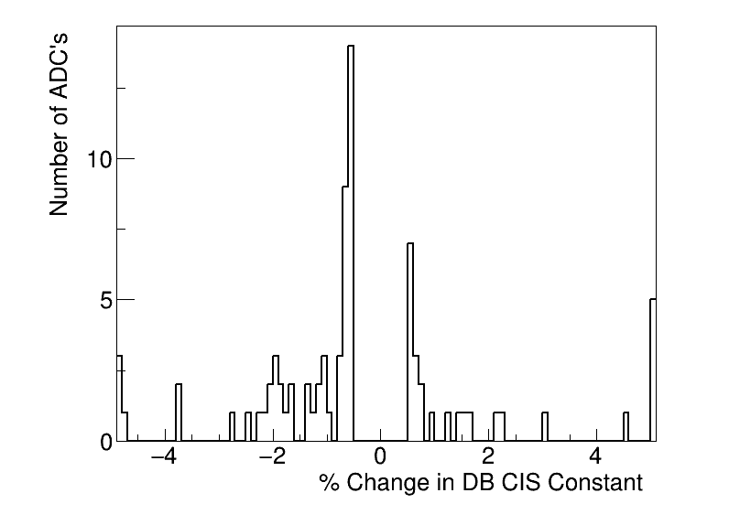
Summary
CIS runs from Feb. 1 - Mar. 1
Plan to push the update today
81 channels in update
20 good
8 with >5% change
7 masked
54 affected
Notes:
Channels in update is much larger than usual (~125)

Slide 3
Runs Removed
411839 (Feb. 21)
LBA_lowgain and EBA_lowgain have bad timing and bad amp/charge
411976 (Feb. 22)
All modules/partitions have bad timing
412108 (Feb. 23)
All modules/partitions have bad timing
LBA_lowgain has bad amp/charge

Slide 4
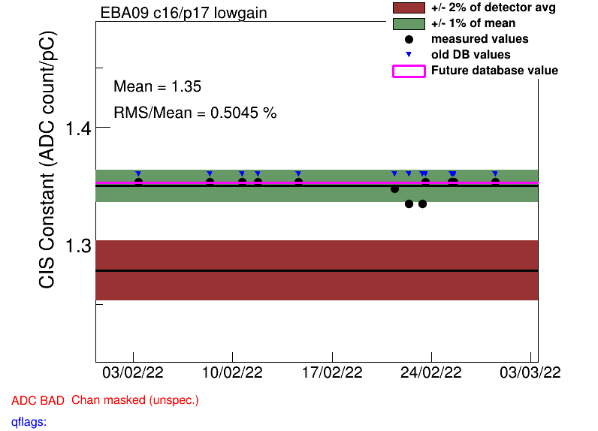
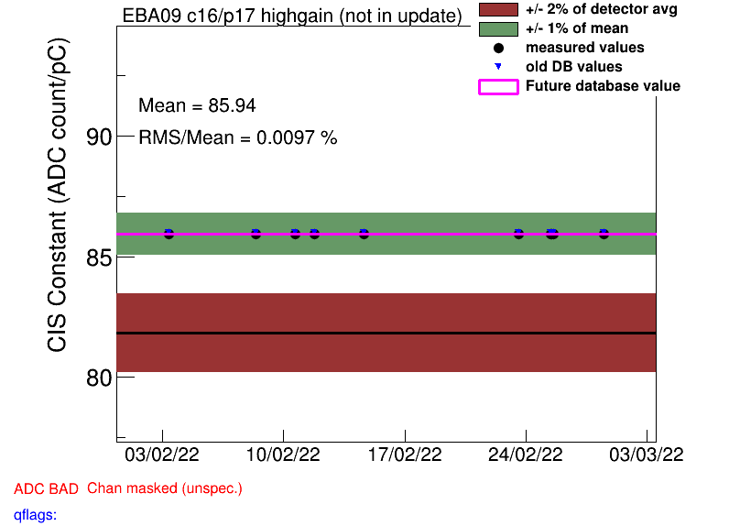
Runs Removed

Slide 5
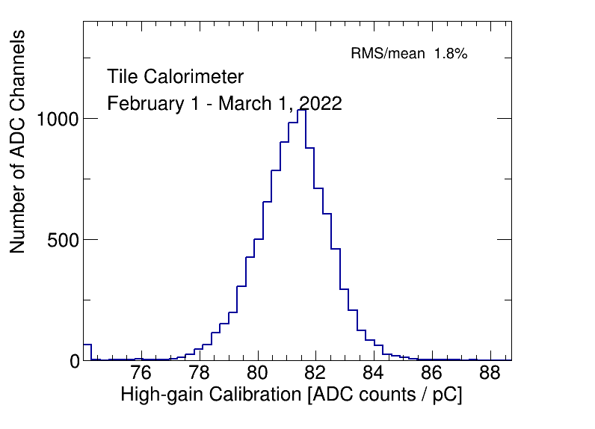
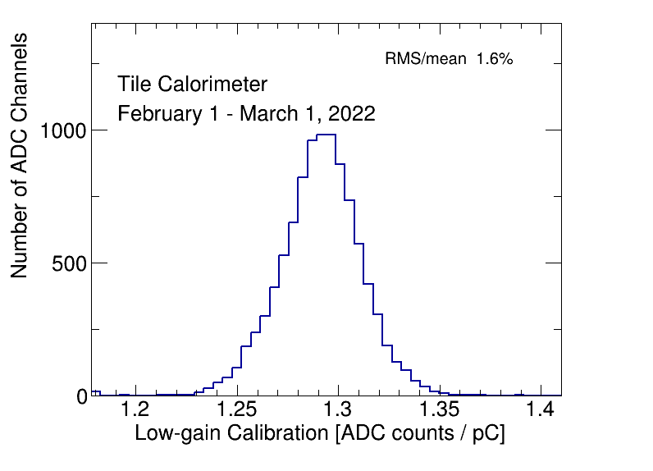
CIS constant distributions

Slide 6
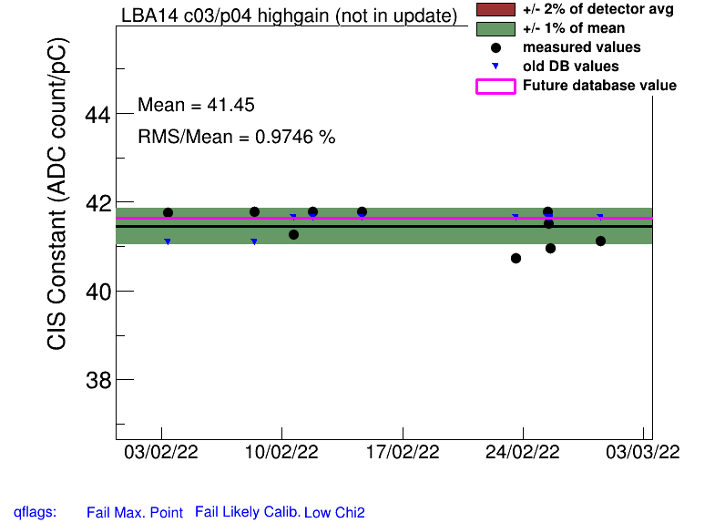
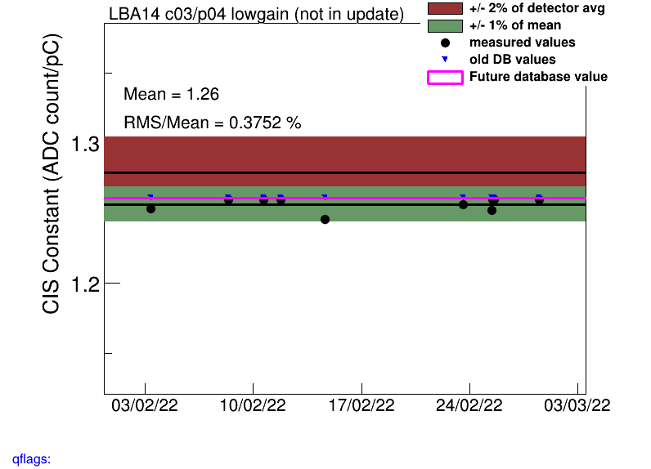
CIS constant distributions
This bump on the HG distribution is from LBA14, which is expected to be at half gain but is not to be marked as BadCIS

Slide 7
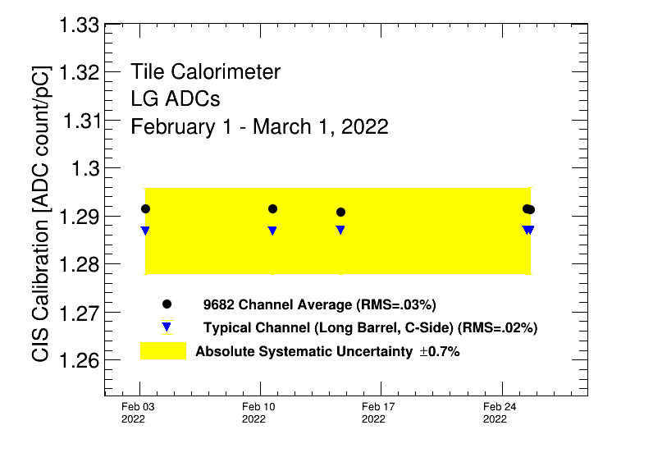
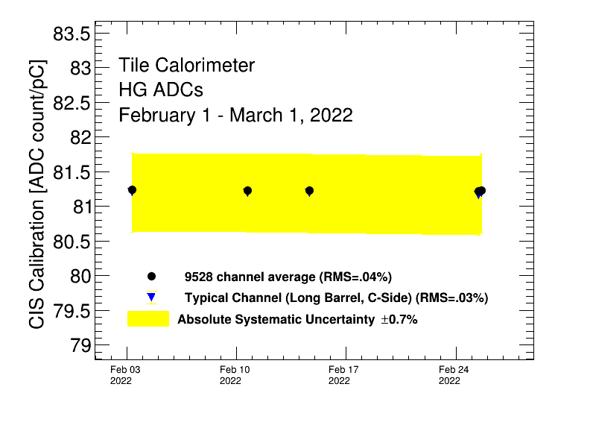
Detector stability

Slide 8
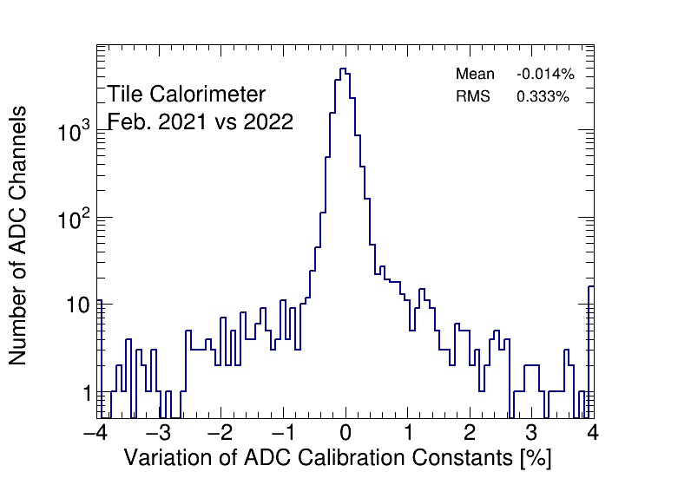
CIS constant stability

Slide 9
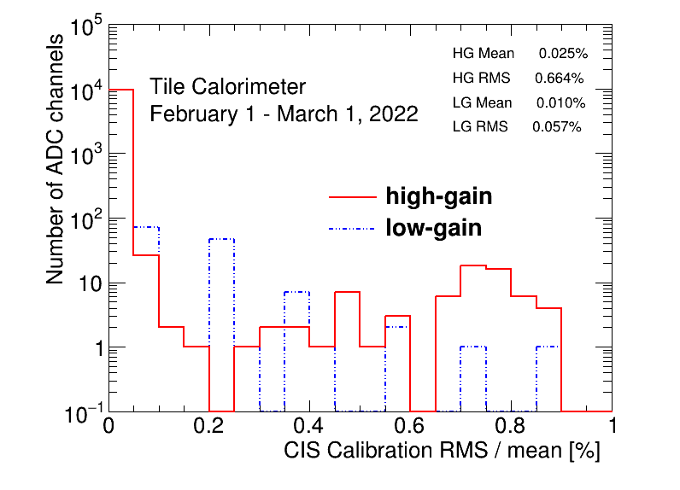
CIS constant RMS/mean

Slide 10
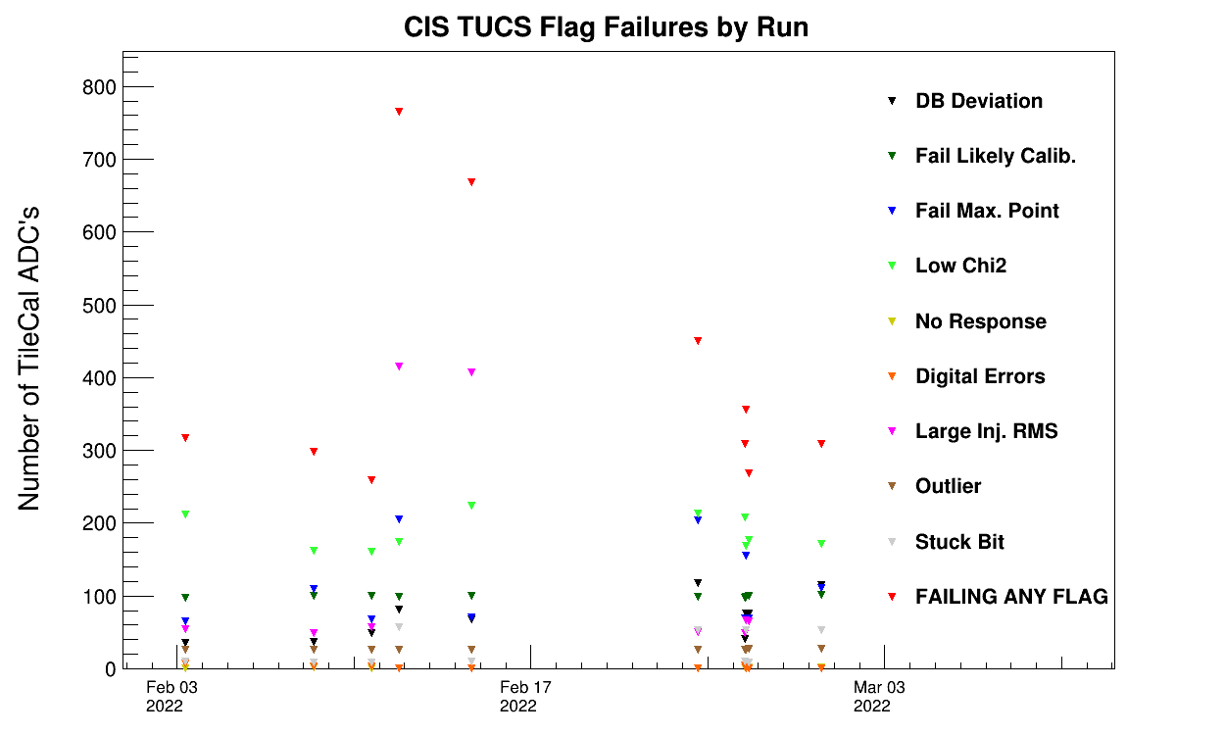
CIS TUCS Quality Flags

Slide 11
Interesting channel behaviour

Slide 12
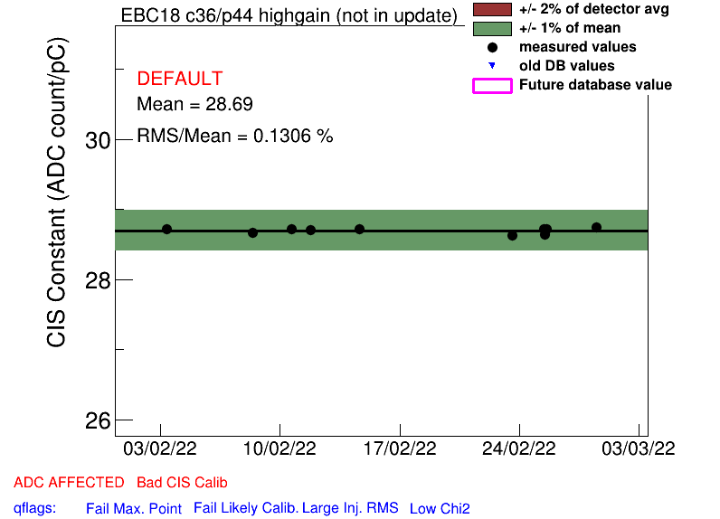
Channels Far from Detector Avg
Highgain (Avg should be 81)
EBC_m18_c36_highgain [28.69]
EBC_m23_c36_highgain [69.15]
LBA_m62_c26_highgain [15.81]
LBC_m41_c25_highgain [46.84]
LBC_m52_c18_highgain [100.02]
Lowgain (Avg should be 1.29)
EBA_m07_c31_lowgain [1.12]
EBC_m23_c31_lowgain [1.01]
LBC_m23_c20_lowgain [1.61]
LBC_m47_c35_lowgain [1.00]

Slide 13
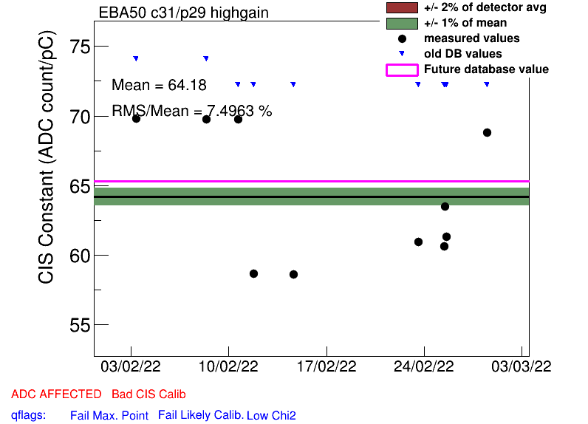
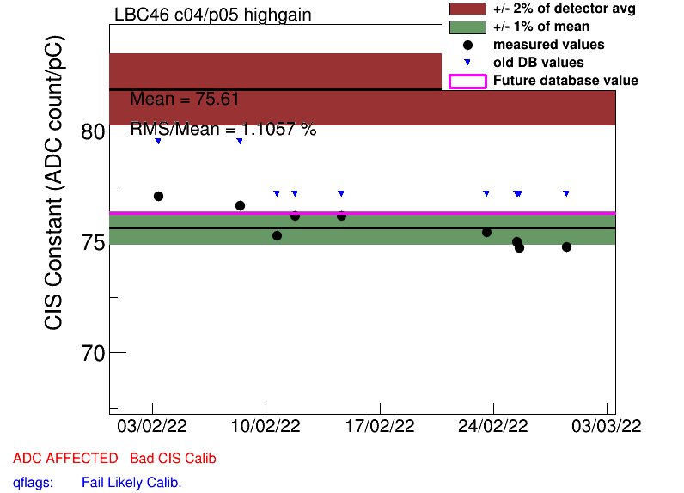
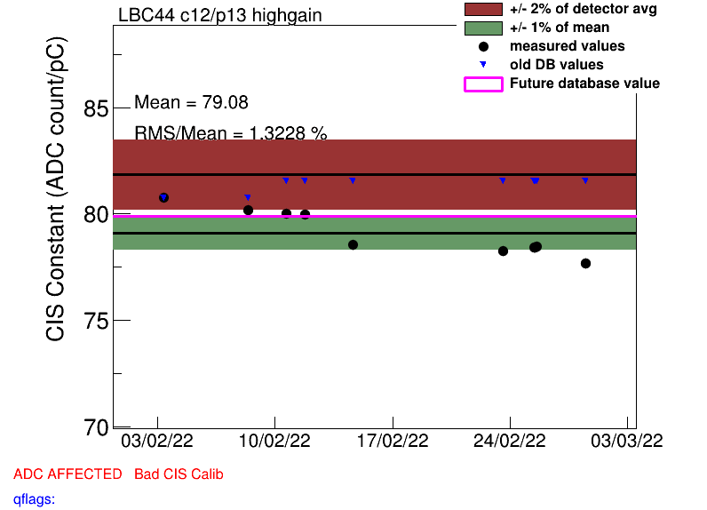
Some High Scatter Channels
EBA_m07_c31_lowgain
EBA_m50_c31_highgain
EBC_m18_c04_lowgain
EBC_m56_c41_lowgain
LBC_m44_c12_highgain
LBC_m46_c04_highgain

Slide 14
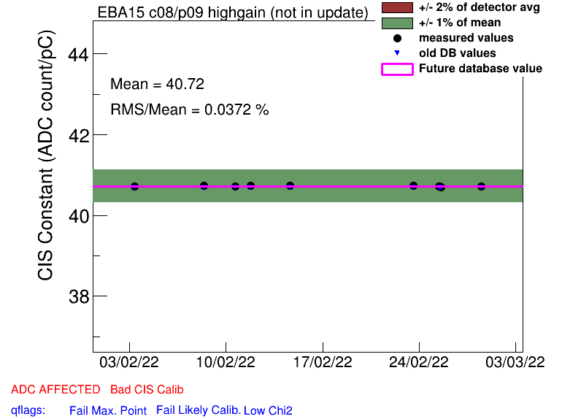
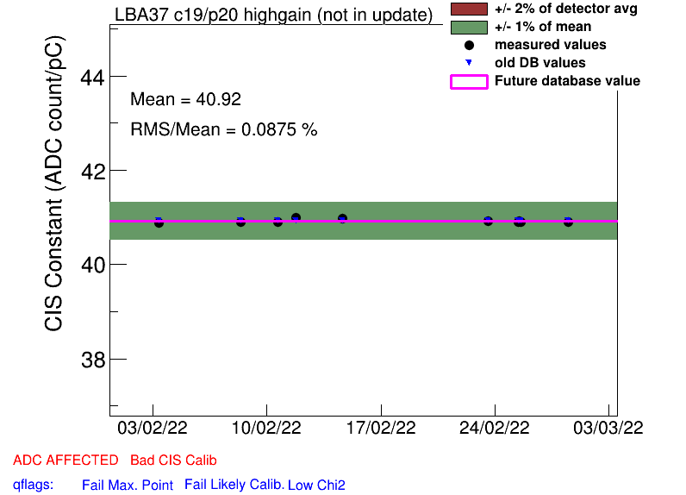
Half Gain Channels
EBA_m15_c08_highgain
EBA_m16_c00_highgain
EBA_m36_c15_highgain
EBA_m48_c31_lowgain
EBA_m64_c03_highgain
EBC_m09_c40_highgain
EBC_m18_c04_lowgain
LBA_m37_c19_highgain

Slide 15
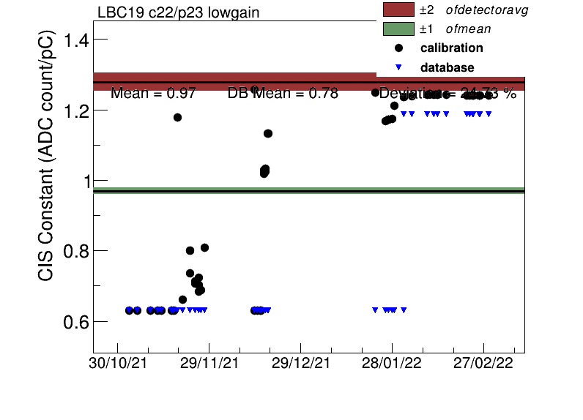
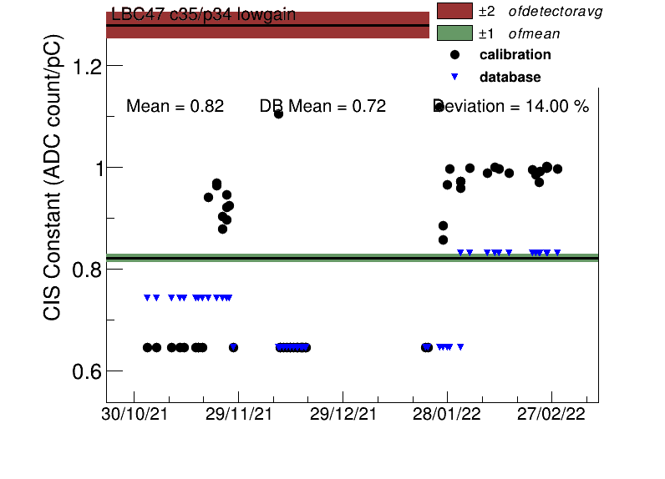
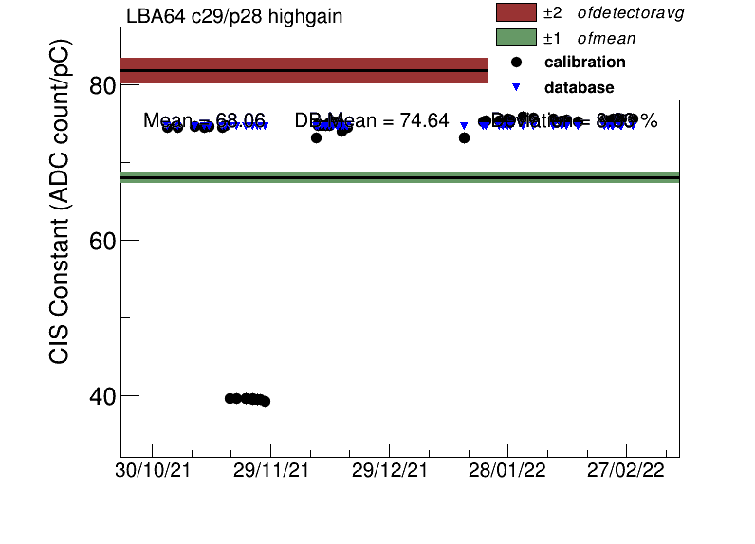
“Recovered” half gain channels
LBC_m19_c22_lowgain
LBC_m47_c35_lowgain
LBA_m64_c29_highgain

Slide 16
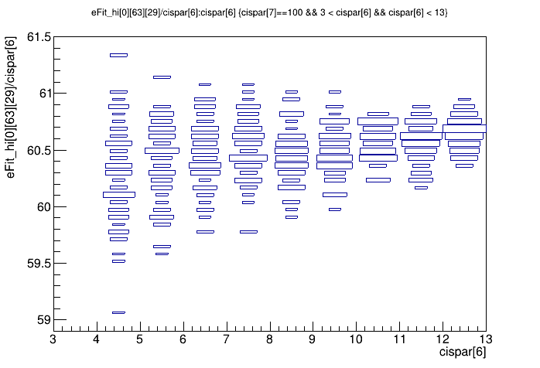
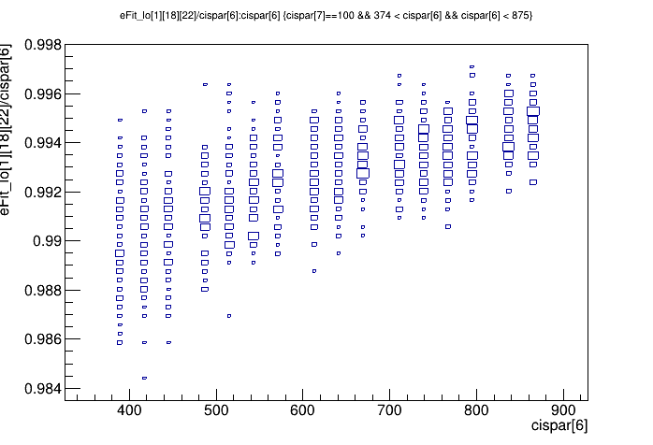
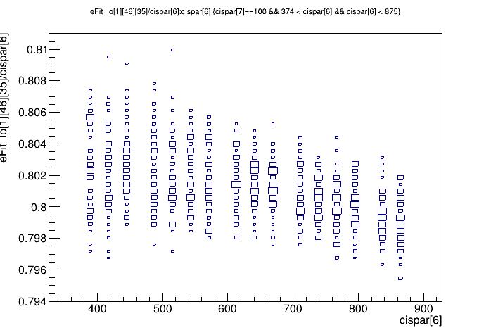
“Recovered” half gain channels:
Amp/charge for run #412491
There are no extreme outliers on the amp/charge plots for these channels
Still working on plotting pulse shapes
LBA_m64_c29_highgain
LBC_m47_c35_lowgain
LBC_m19_c22_lowgain

Slide 17
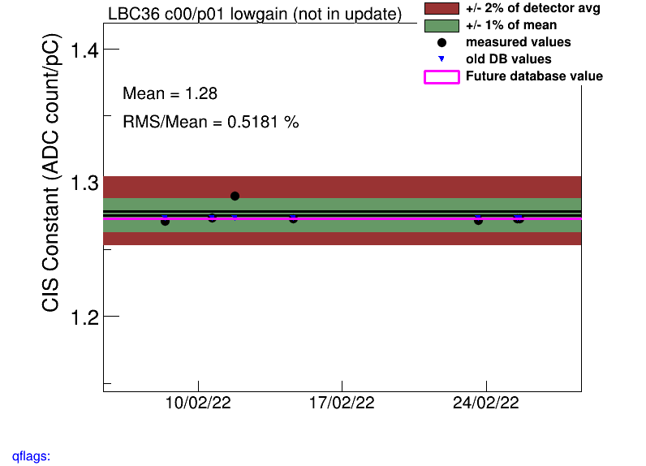
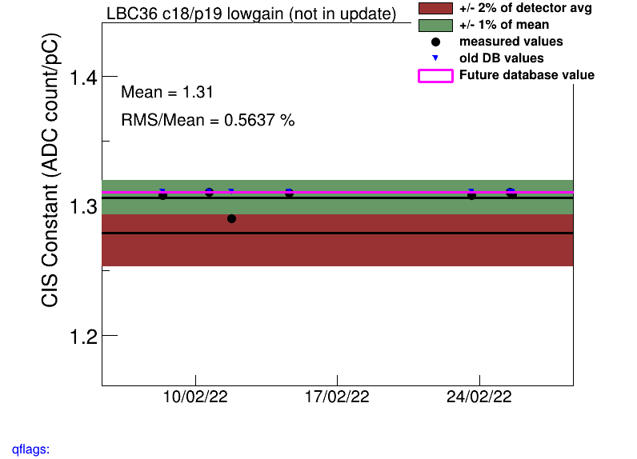
LBC_m36 lowgain
Single point outlier on 2/11 (Run 411022)
Recalibrated all channels after this point

Slide 18
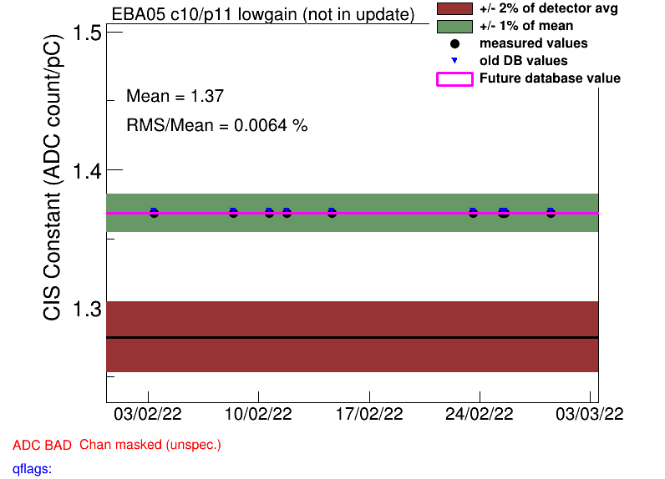
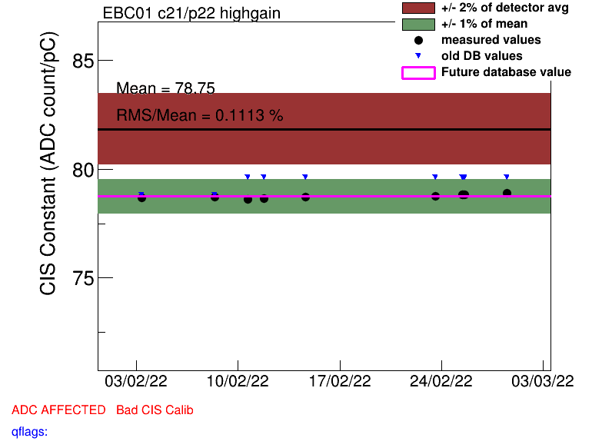
COOL Flag Updates
Remove BadCIS
LBA_m13_c32_lowgain
LBC_m36_c02_highgain
LBC_m57_c06_highgain
LBC_m62_c08_highgain
LBC_m63_c24_highgain
EBC_m01_c21_highgain
EBC_m57_c11_highgain
EBC_m57_c11_lowgain
EBC_m63_c15_lowgain
Add BadCIS
LBA_m06_c38_lowgain
LBA_m37_c21_highgain
LBC_m16_c41_highgain
LBC_m36_c00_lowgain
LBC_m36_c03_lowgain
LBC_m52_c34_highgain
LBC_m52_c34_lowgain
EBA_m05_c10_highgain
EBA_m05_c10_lowgain
EBA_m09_c16_highgain
EBA_m09_c16_lowgain
EBA_m16_c17_highgain
EBA_m48_c05_lowgain

Slide 19
Check Flags (via Pavol’s presentation)
LBA_m35_c08
LG: ADC Bad, Ch. Masked
HG: ADC Bad, Ch. Masked, Bad CIS
LBA_m52_c36 (plots appear to not exist??)
LBA_m03_c07
LG: ADC Affected, Bad CIS
HG: ADC Bad, ADC Masked, Bad CIS
LBA_m04_c44
LG+HG: ADC Bad, ADC Masked, Bad CIS
EBA_m07_c31_lowgain
ADC Bad, ADC Masked, Bad CIS
EBC_m23_c31_lowgain
ADC Bad, ADC Masked, Bad CIS
EBC_m56_c41_lowgain
ADC Bad, ADC Masked, Bad CIS

Slide 20
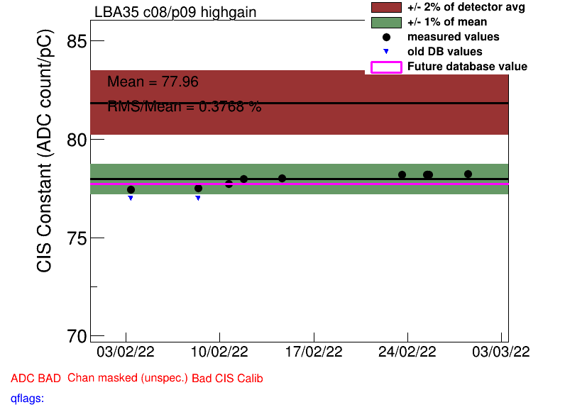
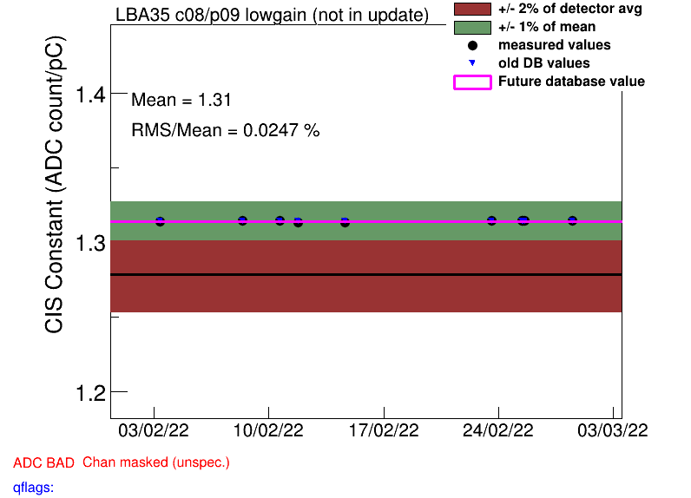

Slide 21
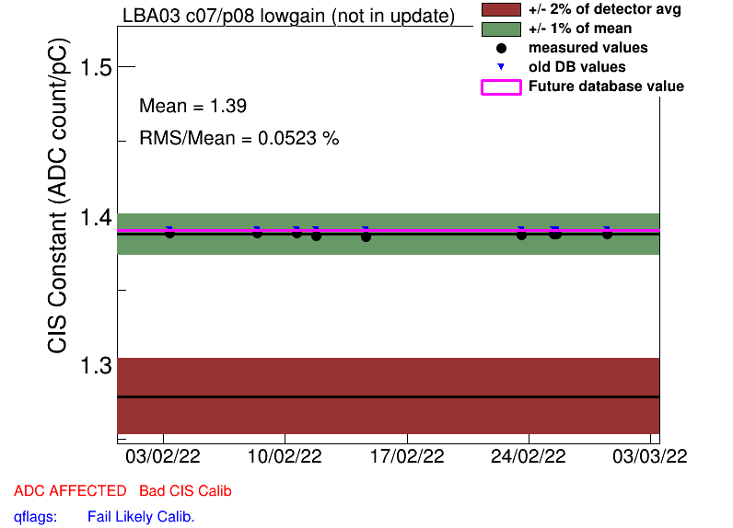
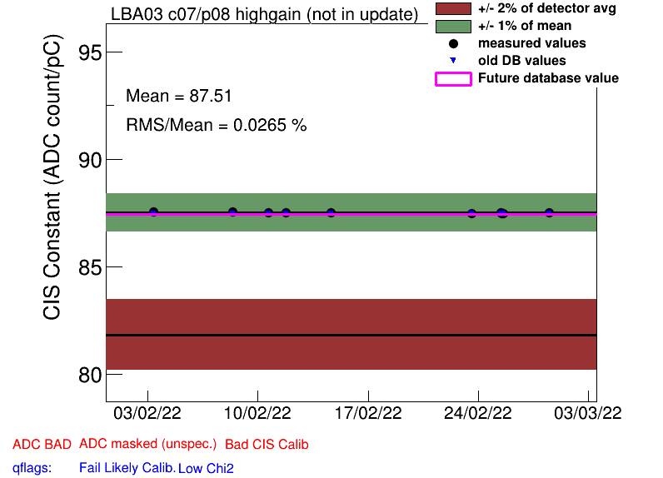

Slide 22
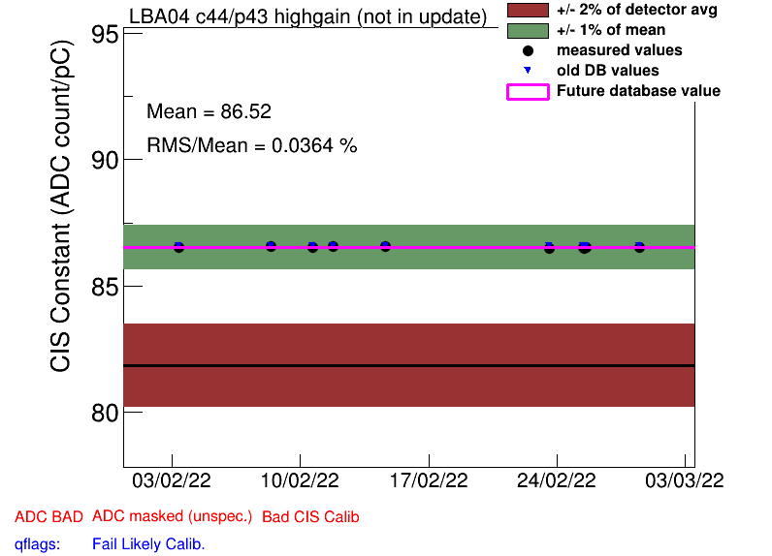
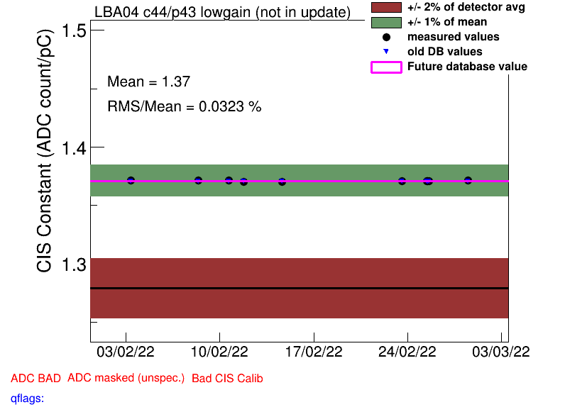

Slide 23
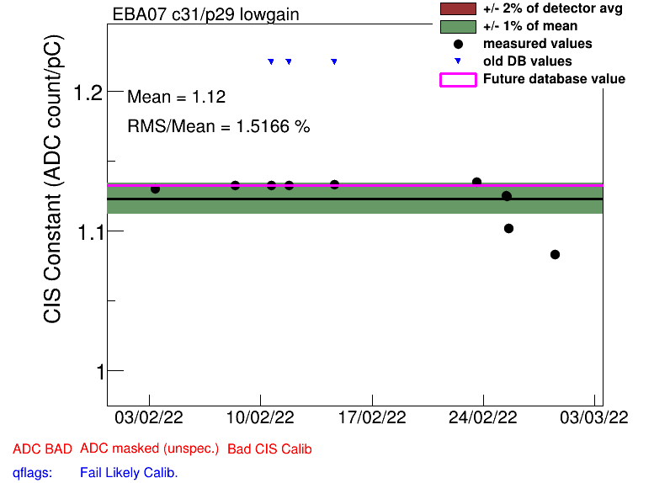

Slide 24
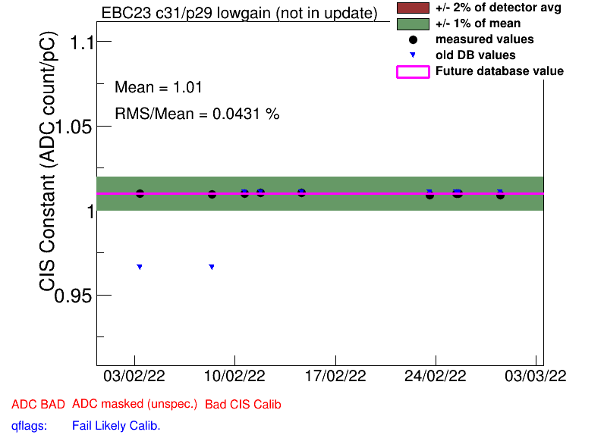

Slide 25
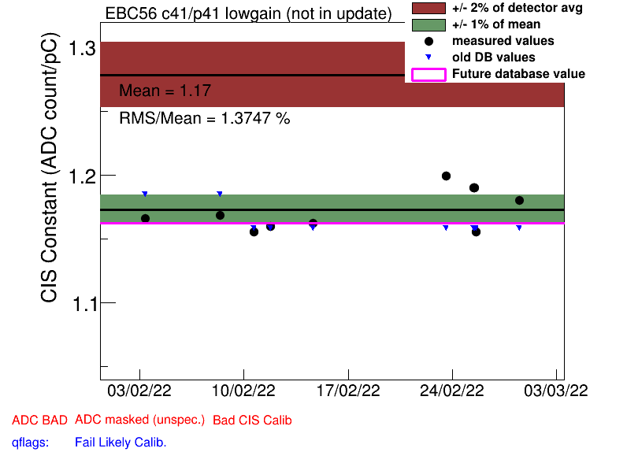

Slide 26
LBC59 (ch 26 HG) and EBC16 (ch 36 LG, ch 39 HG) are now well calibrated, modules turned to green
unfortunately more modules show problems now
LBA35 ch 8 HG (Amp/Q now 1.4)
LBC47 ch 15 LG (Amp/Q now 1.2) ********
LBC57 ch 6 HG (Amp/Q now 1.5)
EBA61 ch 15 HG (Amp/Q now 0.93, maybe at threshold with original calib?)
EBA64 ch 3 HG (Amp/Q now 0.5)
EBC61 ch 8 LG (Amp/Q now 1.2)
why the calibration did not improve EBA50 ch 31 HG, EBC18 ch 36 HG?
EBA07 ch 31 LG overcalibrated now (Amp/Q 1.2 → 0.9)
CIS calibration must be double checked and updates discussed with DQ team

Slide 28
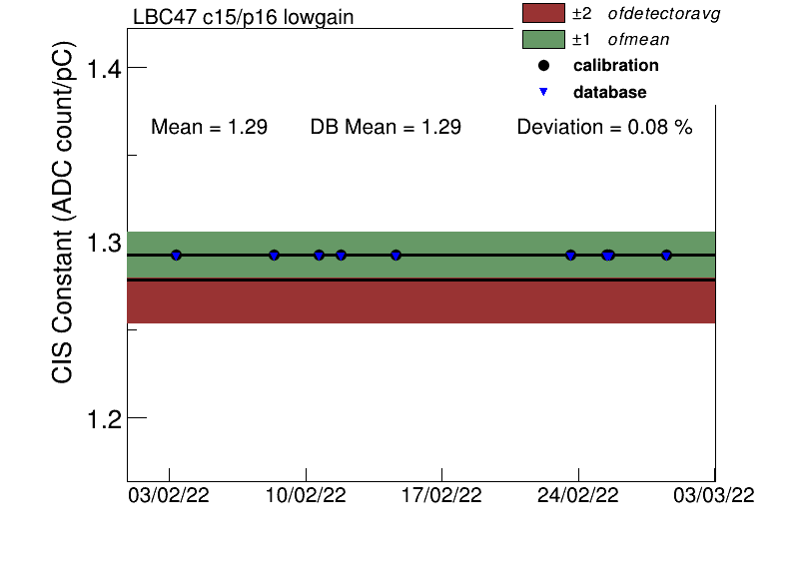

Slide 29
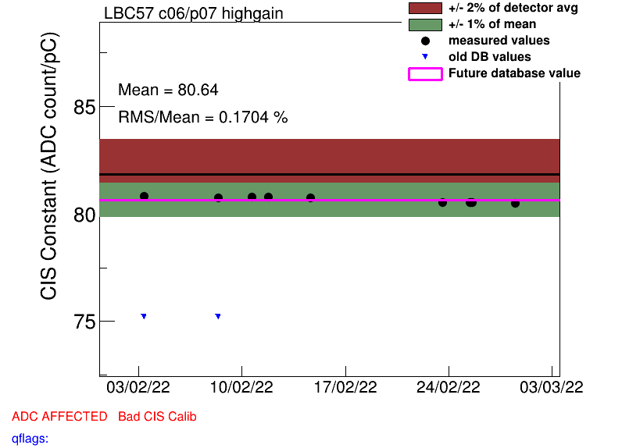

Slide 30
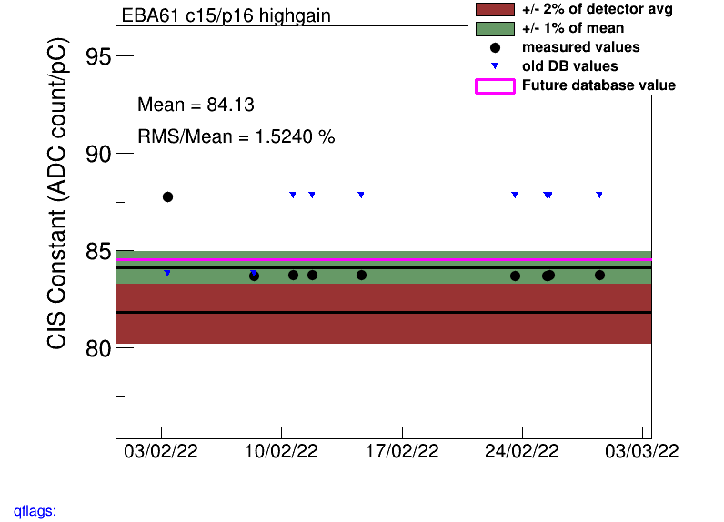

Slide 31
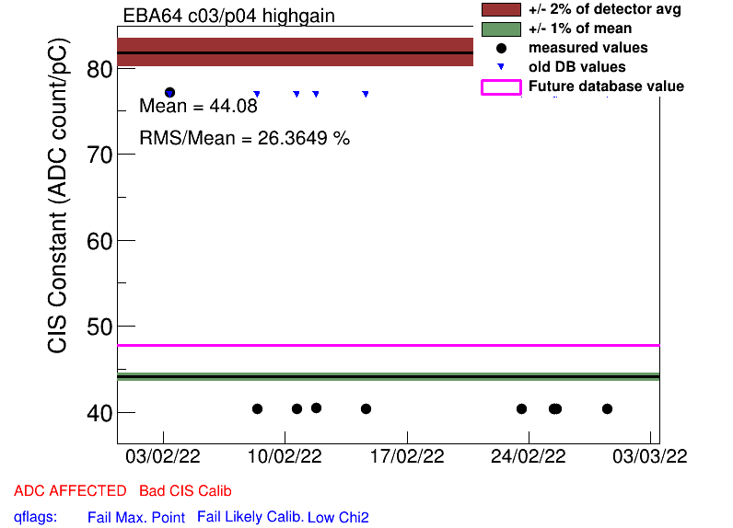

Slide 32
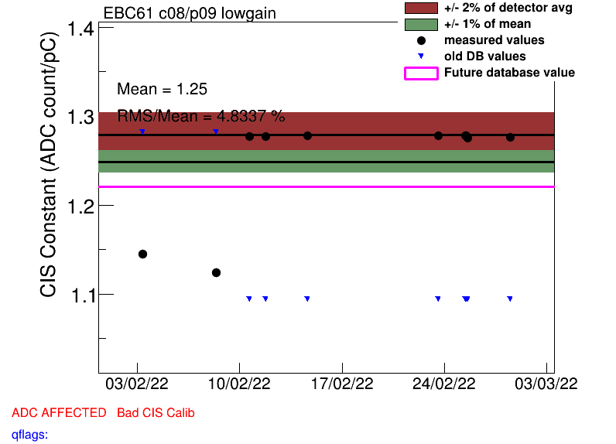

Slide 36
